Slide 1
Physiotherapy treatment for age appropriate pediatric neurological conditions

Slide 2
Most common pediatric conditions
Cerebral palsy (CP)
Muscular dystrophy (MD)
Spina bifida
Down’s syndrome
Developmental delay
Seizure disorder
Burns
Torticollis
Congenital malformations
Prematurity
Cystic fibrosis
Sports injuries
Traumatic brain injury (TBI)
Autism spectrum disorder
Juvenile arthritis

Slide 3
Cerebral palsy
Non progressive disorder of voluntary movement and/or posture that is caused by damage to the immature brain before, during or after birth (upto 2 years of age).
Classification: (by part of body affected)
Monoplegia- one limb
Paraplegia- legs only
Hemiplegia- one side of body
Triplegia- three limbs
Quadriplegia- all four limbs
Diplegia- primarily both legs, arms may be affected minimally
Double hemiplegia- arms more than legs

Slide 4
Cerebral palsy
Types:
Spastic- damage to cortex, pyramidal tract. Tone is hypertonic.
Athetoid- damage to basal ganglia, extra pyramidal tracts. Tone is fluctuating.
Ataxic- Damage to cerebellum, extrapyramidal, balance and co-ordination are affected.
Mixed- mixture of all, mixed symptoms
Causes:
Prematurity
Problems with intrauterine development
Birth trauma (e.g. lack of oxygen)
Traumatic brain injury
Child abuse (shaken baby syndrome)
Unknown cause

Slide 5
Cerebral palsy
Associated disabilities:
Developmental delay
Cognitive impairement
Medical complications
Seizures (28%)
Visual auditory deficits (42-58%)
Sensory disorder
Learning and behavioural difficulties (23-56%)

Slide 6
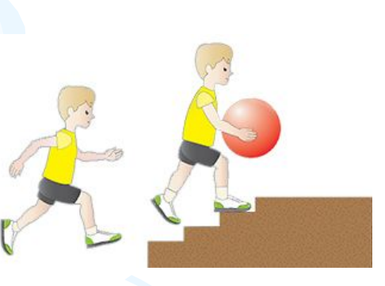
Cerebral palsy
GMFM level 1
Can walk indoors and outdoors and climb stairs without using hands for support.
Can perform usual activities such as running and jumping.
Has decreased speed, balance and co-ordination.

Slide 7
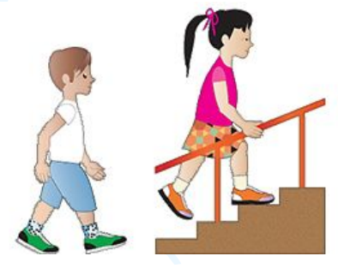
Cerebral palsy
GMFM level 2
Has the ability to walk indoors and outdoors and climb stairs with railing.
Has difficulty with uneven surfaces, inclines or in crowds
Has only minimal ability to run or jump

Slide 8
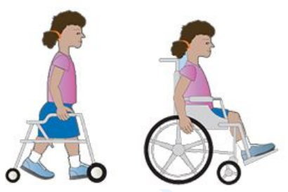
Cerebral palsy
GMFM level 3
Walks with assistive mobility devices indoors and outdoors on level surfaces.
May be able to climb stairs using a railing.
May propel a manual wheelchair (may require assistance for long distances or uneven surfaces).

Slide 9
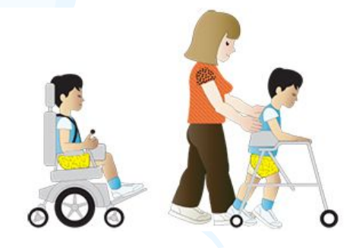
Cerebral palsy
GMFM level 4
Walking ability is severely limited even with assistive devices.
Uses wheelchairs most of the time or they may propel their own powered wheelchair.
May participate in standing transfers.

Slide 10
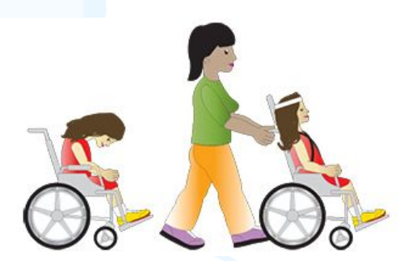
Cerebral palsy
GMFM level 5
Has physical impairments that restricts voluntary control of movement and ability to maintain head and neck position against gravity.
Is impaired in all areas of motor function.
Can not sit or stand independently, even with adaptive equipment.
Cannot independently walk, though may be able to use powered mobility.

Slide 11
Cerebral palsy- impairments
Abnormal tone in muscles
Hypermobility (loose)
Hypomobility (tight, contractures)
Weakness
Abnormal reflexes
Sensory deficits
Cognitive impairments
Visual/auditory deficits
Medical complications
Seizures

Slide 12
Cerebral palsy- limitations
Restrictions in activities
Gait
Transitional movements
Oral-motor control
GM and FM skills
Communication difficulties
Learning disabilities
ADL
Social
Recreation
Employment

Slide 13
Cerebral palsy- treatment options
Treatment options-
PT, OT, ST
Bracing/orthotics
Assistive devices
Adaptive equipment
Communication device
Therapeutic exercise
Medication
Surgery
Aquatic therapy
Botox injections
Sensory integration therapy

Slide 14
MUSCULAR DYSTROPHY
Neuromuscular disease that cause progressive muscle weakness and loss of function.
Many forms present:
Duchenne muscular dystrophy is the most common form occurring about 1 in every 3500 live male births.
DMD is an X linked inherited disease, involving a mutation of xp21 which involves the coding for protein dystrophin.

Slide 15
DMD
Children with DMD have absence of dystrophin.
Dystrophin is in the sacroleminal membrane.
The loss of dystrophin causes the fibers to breakdown;
Leads to weakness and loss of function.
Weakness proximal to distal;
-early weakness in neck flexors and pelvic girdle muscles.
- Distal muscle weakness occurs last, facial muscles are not usually involved.

Slide 16
DMD Changes over time
Wide base of support.
Lordosis
Knee hyperextension
Retracted shoulders
Ankle plantarflexion
Iliotibial band contractures
Hip flexor contractures
Toe walking
Frequent falling
Difficulty climbing stairs

Slide 17
DMD- characteristics
Progressive weakness, proximal>distal
Muscle contractures
Impaired balance, posture
Progressive scoliosis
Presence of ‘Gower’s sign’
Atypical posture
May have learning disabilities

Slide 18
DMD Prognosis
Usually diagnosed at preschool age, often symptoms don’t appear until age 5
Progressive weakness with loss of ambulation around age 12
Decreased heart and lung in teenage years due to weakness in respiratory and cardiac muscle
Decreased GI function (constipation and impaction) due to weakness of smooth muscle
Expected life span upto late teen years and twenties
Treatment options:
Maintain strength/ endurance/ ROM
Splinting/ bracing/ contracture management- surgical release of tight muscles
Adaptive devices/ equipment to optimize functional mobility
Respiratory care

Slide 19
Down syndrome
A genetic disorder in which chromosome 21 divides incorrectly leading to a third chromosome (“trisomy 21”) resulting in mental retardation and medical complications.
Is one of the most common genetic birth defects, occurring in about 1 in 800 births (increased incidence with increased maternal age).

Slide 20
Down syndrome
Common physical features:
Flat facial profile
Upward slanted eyes
Short neck
Short arms/ legs
Smaller mouth, tongue appears large
Ears that may fold over
Flattened nasal bridge
Hands have deep transverse crease in palm and fingers may be short
Common physical impairments:
Hypotonia
Loose ligaments and hypermobile joints
Pes planus/ flexible flat feet
Decreased strength and balance
Patellofemoral disorders
Atlantoaxial (C1-C2) instability 15% of the time, which may lead to spinal cord compression.

Slide 21
Down syndrome
Cognitive, communication and learning impairments:
Mental retardation can be mild to severe
Learning disabilities may be present requiring special education
Receptive and expressive language may be delayed requiring speech therapy, augmentative communication and/ or sign language.
Gross motor and mobility skills:
Gross motor skills are delayed due to low muscle tone, loose ligaments and decreased strength.
Walking usually occurs around age 2 .
Gross motor development continues throughout lifespan, yet it remains delayed.
Increased incidence of overweight with age may affect fitness level.

Slide 22
Down syndrome
Physical therapy:
PT from birth through adulthood
ESS, school, outpatient
Therapy focus: strengthening, balance and gross & fine motor skills mobility.
Orthotics (evidence is mixed concerning their value)
Parent education
Prognosis and outcomes:
Life expectancy is 55 years
Education and work training available allowing great opportunity for productivity: may go onto college, have jobs and live independently.
Incidence of Alzheimer's disease is 25% in adults over age 32.

Slide 23
Seizure disorders
Seizure: uncontrolled electrical activity in the brain which may produce physical or other symptoms
Epilepsy: a neurologic disorder marked by recurrent seizure episodes due to abnormal electrical activity in the brain
Seizure Causes:
● Birth trauma
● Congenital conditions
● Brain tumor
● Degenerative brain disorders
● Poisoning
● Fever or infection
● Stroke
● Medication
● Emotional stress
● Change in blood sugar

Slide 24
Seizure Disorders
Types
Focal seizures: abnormal electrical activity involving one or more areas in one hemisphere of the brain
– May often experience an aura (involving senses of hearing, vision, or smell prior to seizure)
Simple or complex
May see behaviors such as gagging, lip smacking, spinning, screaming, crying, laughing
Generalized seizures: involve both hemispheres of the brain
– Absence seizures: child usually presents as staring and may not recall the seizure
-Generally don’t last longer than 30 seconds
– Atonic seizures: sudden loss of muscle tone, may cause drop attacks
– Tonic seizures: sudden stiffening of parts of entire body
– Generalized tonic-clonic seizure: also known as grand mal seizure

Slide 25
Seizure disorders
Symptoms
● Jerking movements in the extremities
• Stiffening of the body
• Loss of consciousness
• Breathing impairments
• Loss of bowel or bladder control
• Falling suddenly for no apparent reason
• Extreme sleepiness and irritability when waking up in the morning
• Head nodding
• Periods of rapid eye blinking and staring

Slide 26
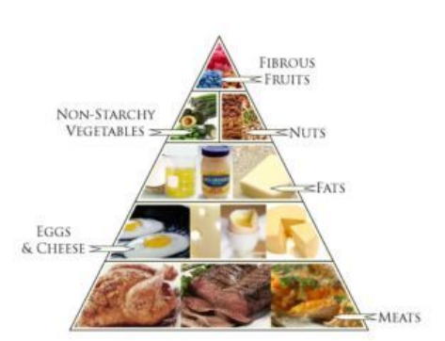
Seizure (what can you do?)
Ketogenic diet:

Slide 27
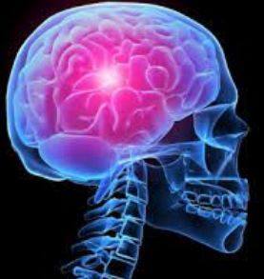
Seizures
What can you do to help:
Note time seizure started, how long it lasts, what type of movements you saw
Move chairs, tables, objects out of the way for safety
If child is standing, gently ease to floor
Stay with child until seizure is over
Treatment:
Anti-seizure medication
Ketogenic diet
http://www.epilepsy.com/learn/treatingseizuresandepilepsy/dietarytherapies/ketogenic-diet
Vagal nerve stimulator

Slide 28
Seizures
Vagal Nerve Stimulator(VNS): pacemaker implanted below the skin inferior to the clavicle
-Delivers small pulses of electrical stimulation to the vagus nerve
-Acts like a “pacemaker of the brain”
- Holding the magnet to the VNS delivers a burst of stimulation

Slide 29
Autism Spectrum Disorder (ASD)
What is ASD?
● General term for a group of complex disorders of early brain development
● Characterized by difficulties in social interaction, verbal and nonverbal communication and repetitive behaviors
● Autistic disorder….child disintegrative disorder….pervasive developmental disorder-not otherwise specified (PDD-NOS)... =ASD (DSM-5)
DSM-5: The Diagnostic and Statistical Manual of Mental Disorders, Fifth Edition (DSM-5) is a handbook that health care professionals use to diagnose mental disorders, including autism spectrum disorder (ASD).

Slide 30
Autism Spectrum Disorder
DSM-5
• Persistent deficits in social communication and social interaction across multiple contexts
• Restricted, repetitive patterns of behavior, interests, or activities
• Symptoms must be present in the early developmental period (but may not become fully manifest until social demands exceed limited capacities, or may be masked by learned strategies in later life)
• Symptoms cause clinically significant impairment in social, occupational, or other important areas of current functioning
• These disturbances are not better explained by intellectual disability (intellectual developmental disorder) or global developmental delay

Slide 31
Autism Spectrum Disorder
Prevalence
• 1 in 68 children and 1 in 42 boys
-boys nearly 5x more likely than girls
• 3rd most common developmental disability in US
-fastest growing serious developmental disability in the U.S.
• Costs a family $60,000 a year on average
Cause
• Unknown, but have identified genetic mutations which may directly result in ASD in few cases
• Most cases likely due to genetic predisposition combined with environmental factors (e.g., maternal age, oxygen deprivation around birth, maternal folic acid intake, etc.)
Diagnosis
• Average age of diagnosis is 4-5 years BUT a reliable diagnosis can be made at 18-24 months and researchers are working to lower this age even further

Slide 32
10 Early Warning Signs (6-12 months)
1. Rarely smiles when approached by caregivers
2. Rarely tries to imitate sounds and movements others make, such as smiling and laughing, during simple social exchanges
3. Delayed or infrequent babbling
4. Does not respond to his or her name with increasing consistency from 6-12 months
5. Does not gesture to communicate by 10 months
6. Poor eye contact
7. Seeks your attention infrequently
8. Repeatedly stiffens arms, hands, legs or displays unusual body movements such as rotating the hands on the wrists, uncommon postures or other repetitive behaviors
9. Does not reach up toward you when you reach to pick him or her up
10. Delays in motor development, including delayed rolling over, pushing up and crawling

Slide 33
Autism spectrum disorder
Common Physical Impairments
• Impaired motor coordination
• Impaired postural control
• Impaired motor planning
• Motor delays

Slide 34
ASD
Intervention Considerations
• Applied Behavior Analysis (ABA)
• Early Intervention Programs
• Task Specific Practice
• Physical Activity can improve academic performance and reduce unwanted behaviors
• Promote fine and gross motor skills
• Schedules, visual charts. PECS
• Family education

Slide 35
Additional Pediatric Diagnoses
Genetic disorders
○ Dubowitz Syndrome
○ Tuberous Sclerosis
○ Angelman Syndrome
○ Ehlers-Danlos Syndrome
○ Jacobsen Syndrome
○ Dravet Syndrome
○ Spinal Muscular Atrophy
Brain injury
○ Holoprosencephaly
Acquired
○ Mitochondrial Disorder (acquired or genetic)
○ Plagiocephaly

Slide 36
Thank you

